Slide 1

Monitoring Nvidia GPUs & Infiniband
May 2025
Vinil Vadakkepurakkal(HPC Support)
Sooyoung Moon(HPC GBB)
Microsoft

Slide 2
What is Telegraf?
An open-source server agent used for collecting and reporting metrics, developed by InfluxData.
Key Features:
- Plugin-based architecture: Telegraf supports a wide range of input, output, processor, and aggregator plugins. This allows it to collect data from various sources (like system metrics, databases, message queues, etc.) and send it to different destinations (like InfluxDB, Prometheus, Kafka, etc.).
- Lightweight and efficient: It’s written in Go, making it fast and suitable for running on edge devices or servers with limited resources.
- Extensible: You can write custom plugins if the built-in ones don’t meet your needs.
Common Use Cases:
- Monitoring system performance (CPU, memory, disk, network)
- Collecting metrics from applications, containers, and cloud services
- Sending metrics to time-series databases for analysis and visualization

Slide 3
What is Azure Monitor?
A comprehensive monitoring service provided by Microsoft Azure that helps you collect, analyze, and act on telemetry data from your cloud and on-premises environments.
Key Features:
- Data Collection: Collects metrics, logs, and traces from Azure resources, virtual machines, containers, and applications.
- Data Analysis and Visualization: Use Log Analytics to query and analyze log data using KQL and create dashboards and visualizations in the Azure portal or integrate with Power BI.
- Alerts and Automation: Set up alerts based on metrics or logs to proactively notify you of issues.
- Integration: Works with other Azure services like Azure Security Center, Azure Automation, and Azure Logic Apps.
- Insights: Provides specialized monitoring solutions for services like VMs, containers (Kubernetes), databases, and networking.
Common Use Cases:
- Monitoring the health and performance of Azure resources
- Diagnosing application issues with distributed tracing
- Setting up alerts for anomalies or failures
- Ensuring compliance and auditing with log data

Slide 4
fan_speed (integer, percentage)
fbc_stats_session_count (integer)
fbc_stats_average_fps (integer)
fbc_stats_average_latency (integer)
memory_free (integer, MiB)
memory_used (integer, MiB)
memory_total (integer, MiB)
power_draw (float, W)
temperature_gpu (integer, degrees C)
utilization_gpu (integer, percentage)
utilization_memory (integer, percentage)
utilization_encoder (integer, percentage)
utilization_decoder (integer, percentage)
pcie_link_gen_current (integer)
pcie_link_width_current (integer)
encoder_stats_session_count (integer)
encoder_stats_average_fps (integer)
encoder_stats_average_latency (integer)
clocks_current_graphics (integer, MHz)
clocks_current_sm (integer, MHz)
clocks_current_memory (integer, MHz)
clocks_current_video (integer, MHz)
Telegraf
InfiniBand SMI Plugin Metrics

Slide 5
Infiniband Counters
excessive_buffer_overrun_errors (integer)
link_downed (integer)
link_error_recovery (integer)
local_link_integrity_errors (integer)
multicast_rcv_packets (integer)
multicast_xmit_packets (integer)
port_rcv_constraint_errors (integer)
port_rcv_data (integer)
port_rcv_errors (integer)
port_rcv_packets (integer)
port_rcv_remote_physical_errors (integer)
port_rcv_switch_relay_errors (integer)
port_xmit_constraint_errors (integer)
port_xmit_data (integer)
port_xmit_discards (integer)
port_xmit_packets (integer)
port_xmit_wait (integer)
symbol_error (integer)
unicast_rcv_packets (integer)
unicast_xmit_packets (integer)
VL15_dropped (integer)
Infiniband RDMA counters
duplicate_request (integer)
implied_nak_seq_err (integer)
lifespan (integer)
local_ack_timeout_err (integer)
np_cnp_sent (integer)
np_ecn_marked_roce_packets (integer)
out_of_buffer (integer)
out_of_sequence (integer)
packet_seq_err (integer)
req_cqe_error (integer)
req_cqe_flush_error (integer)
req_remote_access_errors (integer)
req_remote_invalid_request (integer)
resp_cqe_error (integer)
resp_cqe_flush_error (integer)
resp_local_length_error (integer)
resp_remote_access_errors (integer)
rnr_nak_retry_err (integer)
roce_adp_retrans (integer)
roce_adp_retrans_to (integer)
roce_slow_restart (integer)
roce_slow_restart_cnps (integer)
roce_slow_restart_trans (integer)
rp_cnp_handled (integer)
rp_cnp_ignored (integer)
rx_atomic_requests (integer)
rx_icrc_encapsulated (integer)
rx_read_requests (integer)
rx_write_requests (integer)
Telegraf
InfiniBand Input Plugin Metrics

Slide 6
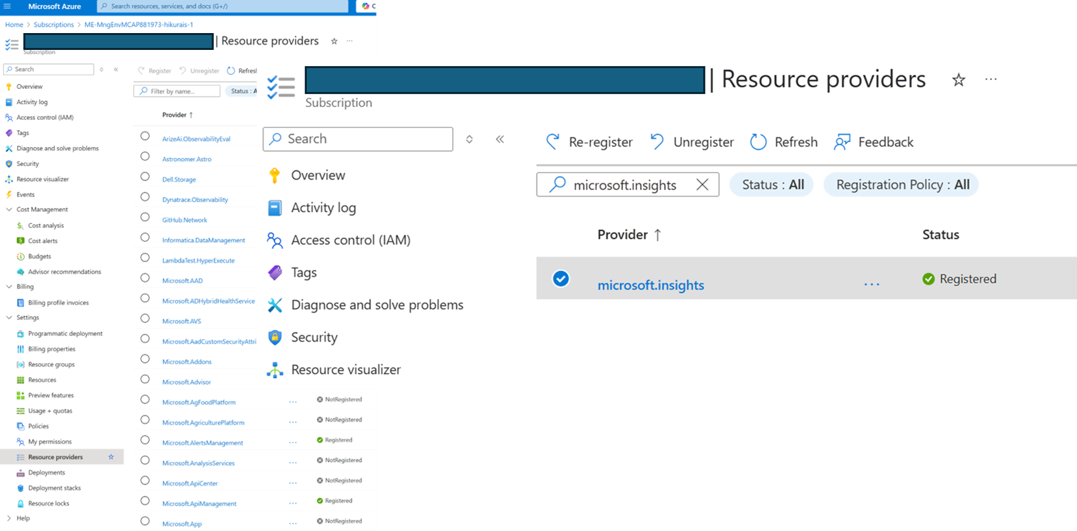
Step 1: Register microsoft.insights in Azure subscription

Slide 7
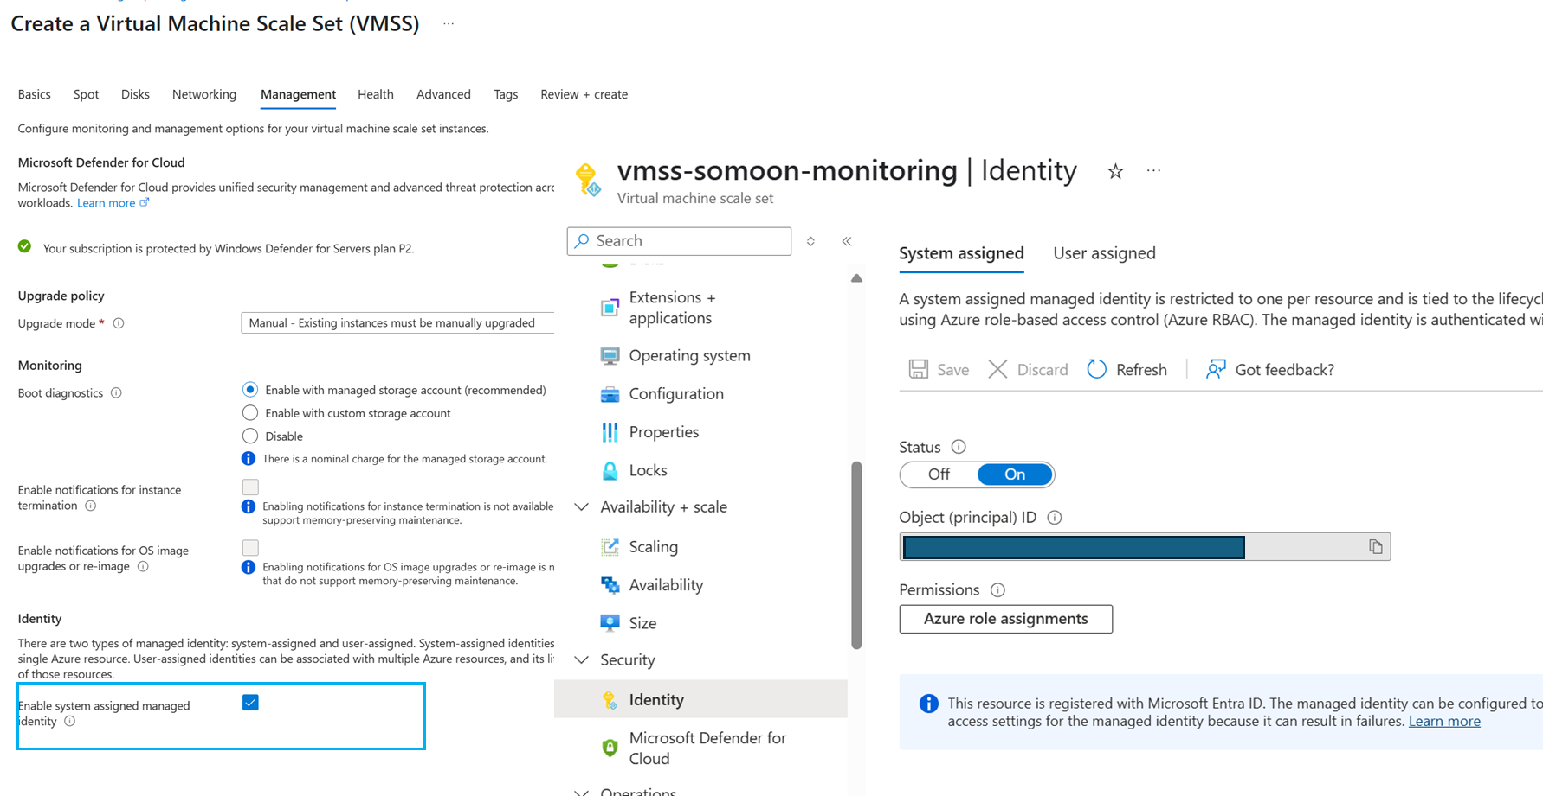
Step 2: Enable System Managed ID
*NOTE:
User Managed ID can be used too.
No role assignment is needed.

Slide 8
Step 3: Install & set up Telegraf Agent inside VM/VMSS instances
wget https://raw.githubusercontent.com/vinil-v/gpu-ib-monitoring/refs/heads/main/scripts/gpu-ib-mon_setup.sh -O gpu-ib-mon_setup.sh
chmod +x gpu-ib-mon_setup.sh
./gpu-ib-mon_setup.sh
sudo telegraf --config /etc/telegraf/telegraf.conf –test
…
infiniband,device=mlx5_ib0,host=vmss-somo000000,port=1 VL15_dropped=0,excessive_buffer_overrun_errors=0,link_downed=0,link_error_recovery=0,local_link_integrity_errors=0,multicast_rcv_packets=1,multicast_xmit_packets=10,port_rcv_constraint_errors=0,port_rcv_data=541,port_rcv_errors=0,port_rcv_packets=8,port_rcv_remote_physical_errors=0,port_rcv_switch_relay_errors=0,port_xmit_constraint_errors=0,port_xmit_data=878,port_xmit_discards=0,port_xmit_packets=17,port_xmit_wait=0,symbol_error=0,unicast_rcv_packets=7,unicast_xmit_packets=7 1747623517000000000
…

Slide 9
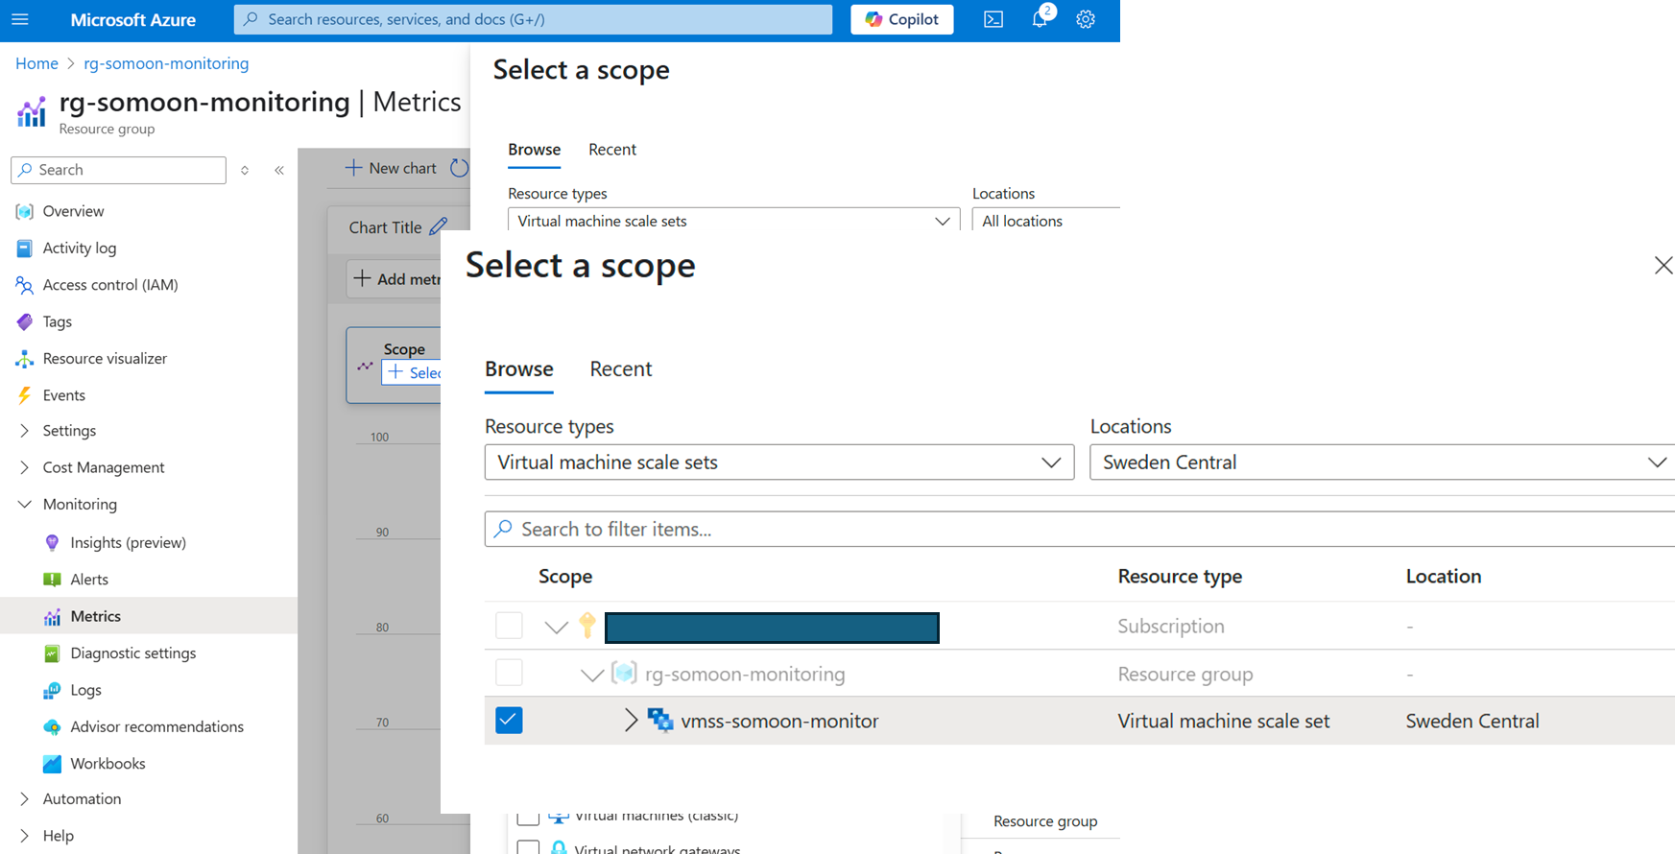
Step 4-1: Define Metrics Scope in Azure Monitor
*NOTE: Select the scope at VMSS level, NOT VMSS instances level!

Slide 10
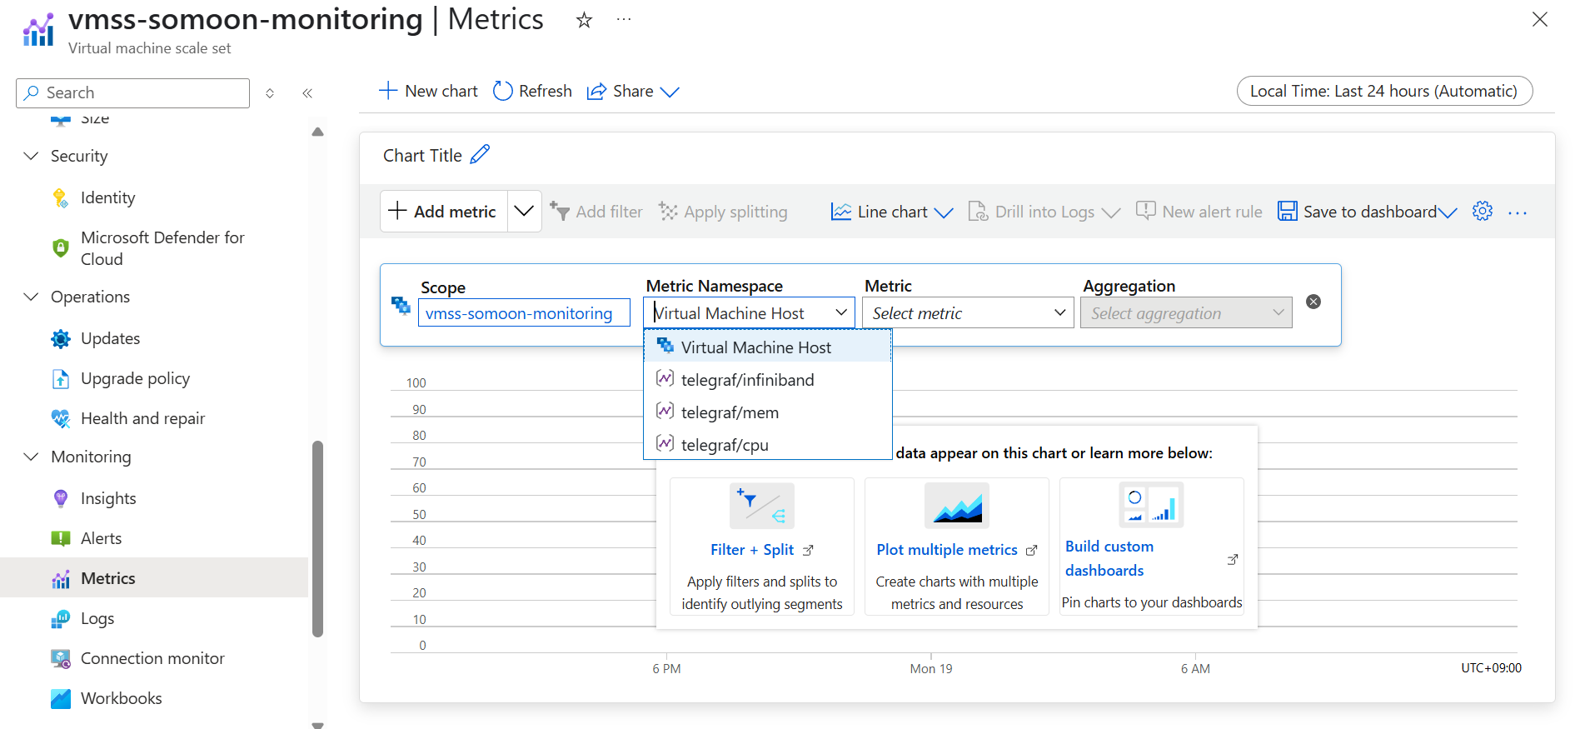
Step 4-2: Define Metrics Namespace in Azure Monitor

Slide 11
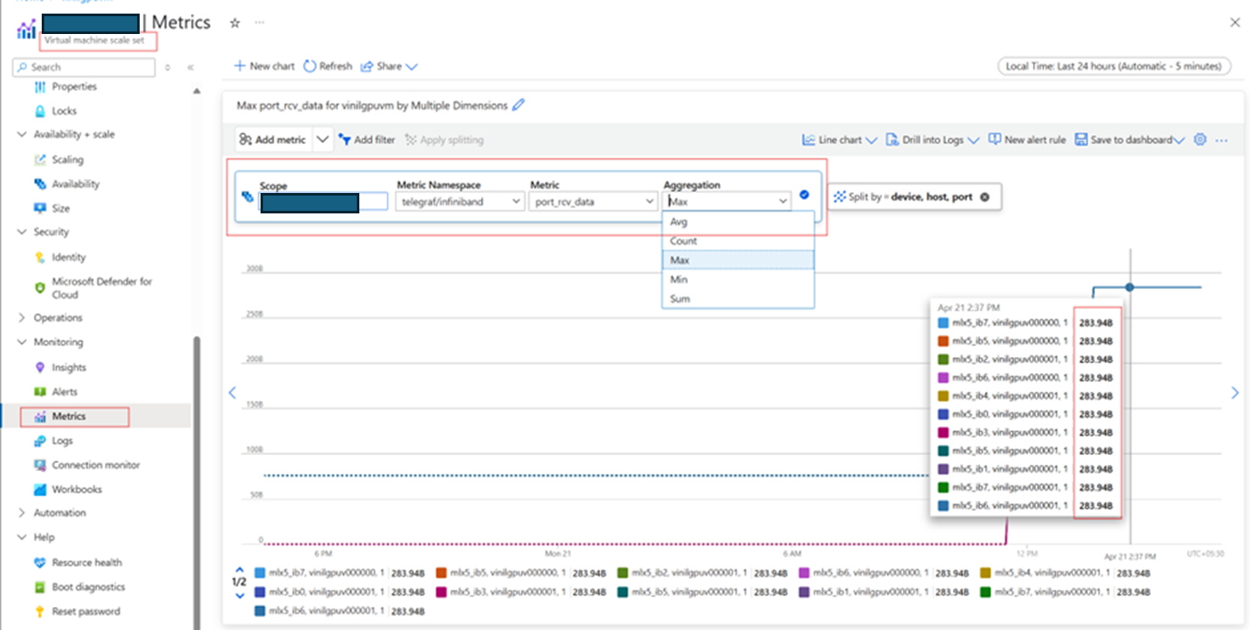
Step 5: Check out metric data

Slide 12
References
Telegraf | InfluxData
Azure Monitor
Monitoring GPU & Infiniband Using Telegraf and Azure Monitor

